Slide 1
Session 5. Device Therapy and Heart Failure 2021.11.13 15:20-15:30
Does Recovery of EF Preclude ICD Generator Replacement?
Yong-Soo Baek, MD, PhD.
Division of Cardiology, Department of Internal Medicine
Inha University Hospital
Inha University College of Medicine

Slide 2
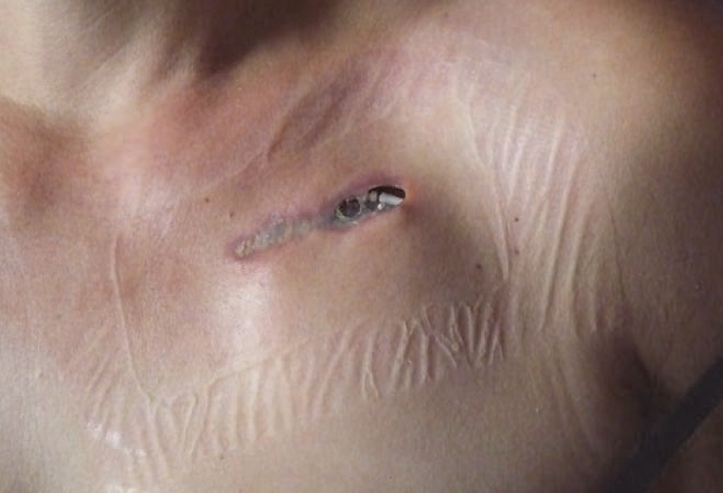
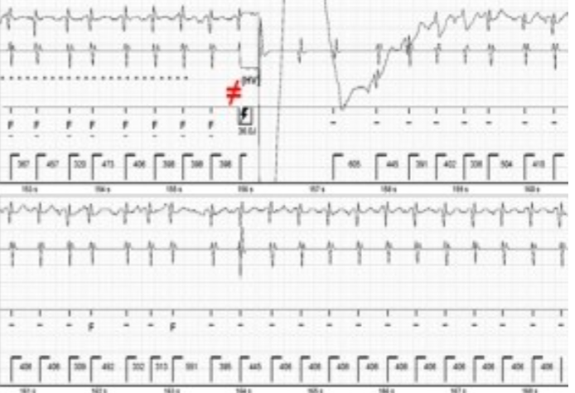
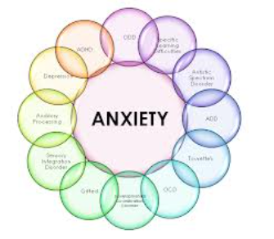
Primary prevention ICD implantation & ICD generator change
Device related complication
(infection, inappropriate discharge, anxiety)
VS.
Prevention of SCD

Slide 3
Generator replacement in recipients of primary prevention ICD therapy
Defining the role of the ICD in patients with different etiologies (ICM vs. NICM vs. HCM, inherited channelopathies…)
After receiving initial device for appropriate indication, some patients may experience improvement or recovery of LVEF
New HF mdeications (RASi, BB, MRA, Ivabradine, Sac/val (ARNI), SGLT2-i),….

Slide 4
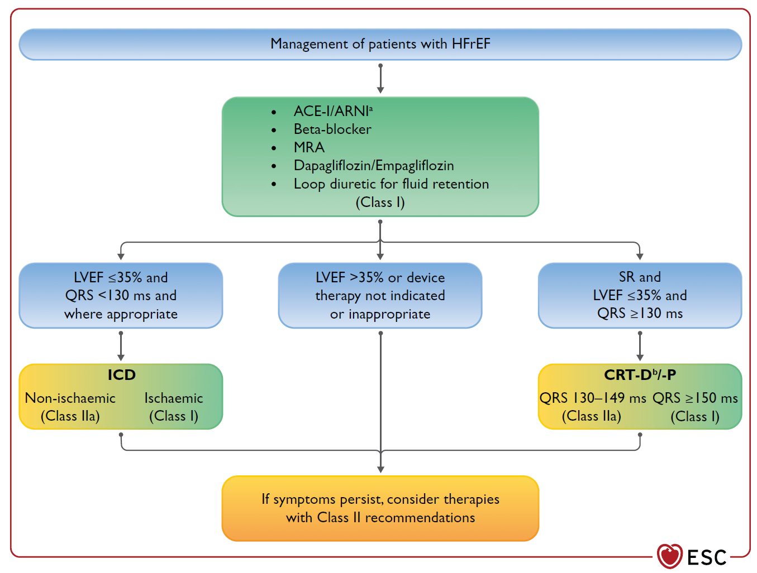
2021 ESC Guidelines for the diagnosis and treatment of acute and chronic heart failure
European Heart Journal (2021) 42, 35993726

Slide 5
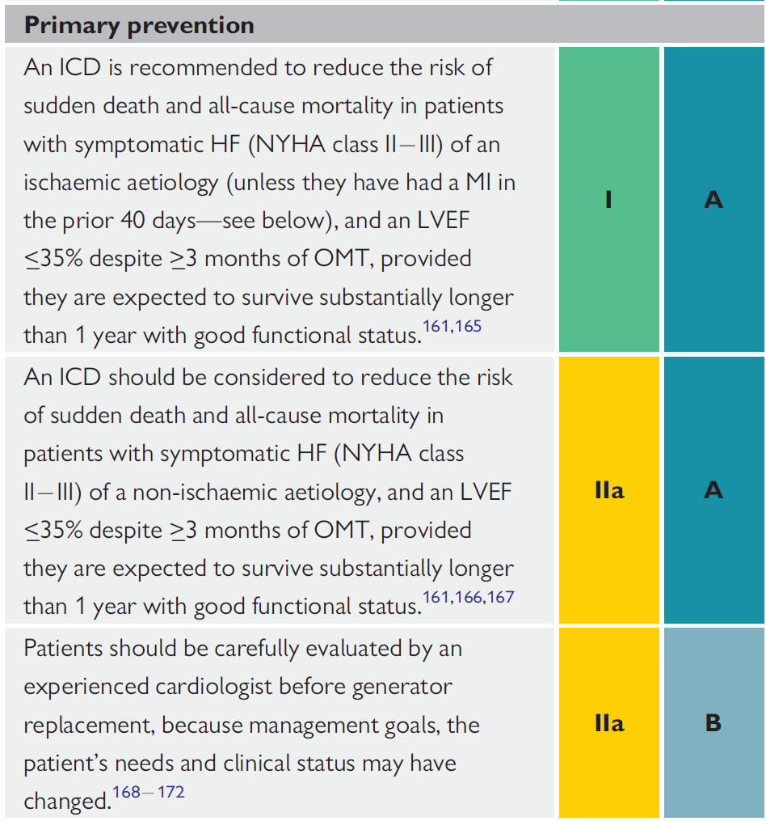
European Heart Journal (2021) 42, 35993726

Slide 6
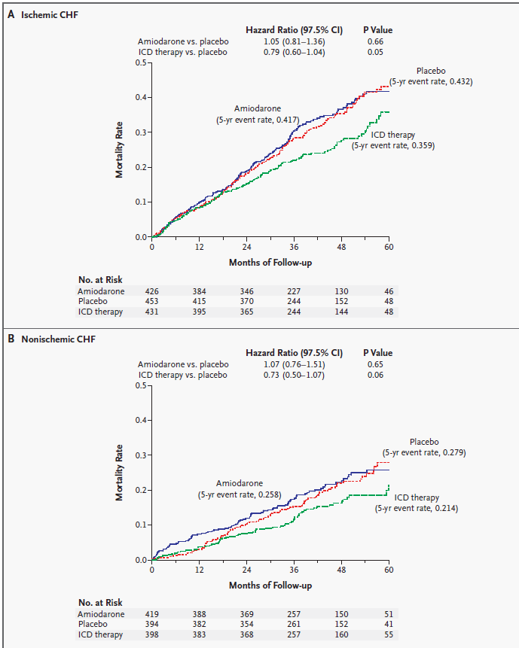
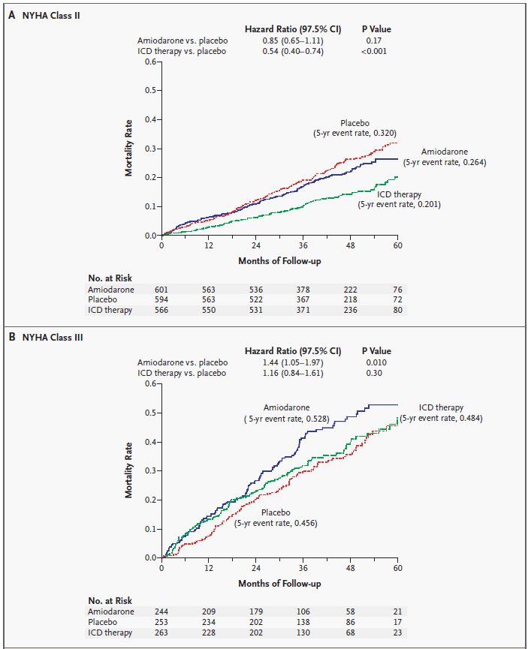
SCD-HeFT trial
LVEF ≤ 35 %, NYHA II-III
Ischemic or non-ischemic
(2521 pts. (792 NICMP))
Medical vs. medical AMD vs. medical +ICD
In patients with NYHA class II or III CHF and LVEF of 35 percent or less, amiodarone has no favorable effect on survival, whereas single-lead, shock-only ICD therapy reduces overall mortality by 23 percent.
N Engl J Med 2005;352:225-37

Slide 7
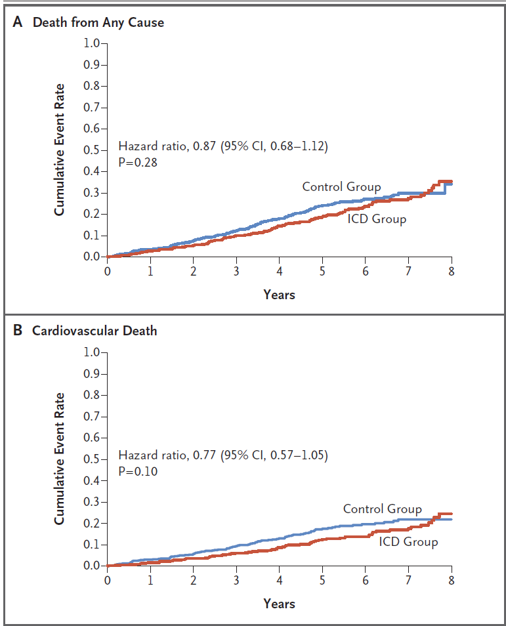
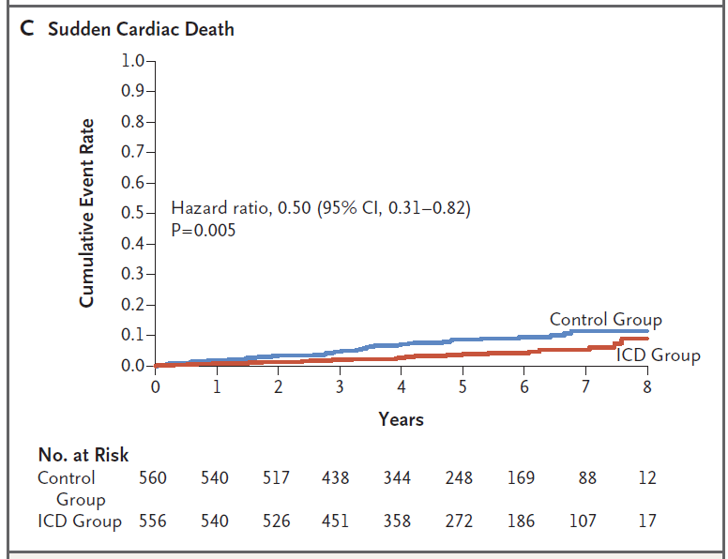
Defibrillator Implantation in Patients with Nonischemic
Systolic Heart Failure (DANISH)
LVEF ≤ 35 %, NYHA II-IV, NT-proBNP>200pg/ml
non-ischemic 1116 pts.
Median f/up 5.6 years
ICD vs. medical
Sudden cardiac death occurred in 24 patients (4.3%) in the ICD group and in 46 patients (8.2%) in the control group (hazard ratio, 0.50; 95% CI, 0.31 to 0.82; P = 0.005).
N Engl J Med 2016;375:1221-30.

Slide 8
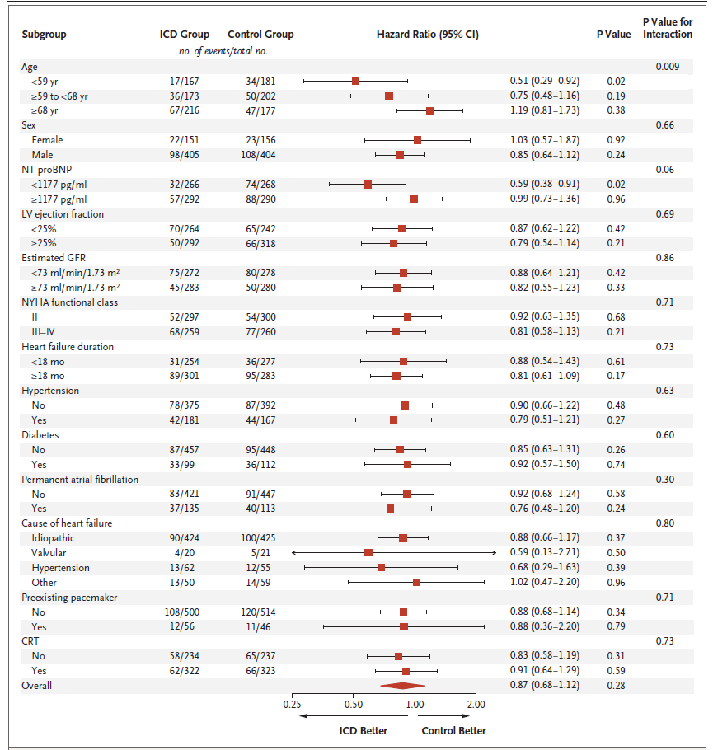
Defibrillator Implantation in Patients with Nonischemic
Systolic Heart Failure (DANISH)
In the subgroup of patients who were younger than 68 years of age, the rate of death from any cause was significantly lower in the ICD group than in the control group (hazard ratio, 0.64; 95% CI, 0.45 to 0.90; P = 0.01). The effect of ICD implantation was independent of CRT status (P = 0.73 for the interaction).
In this trial, prophylactic ICD implantation in patients with symptomatic systolic heart failure not caused by coronary artery disease was not associated with a significantly lower long-term rate of death from any cause than was usual clinical care.
Notes:
현재의 심부전 치료지침에서는 기존의 연구 결과들을 기반으로 비허혈성 심근병증 환자들에게 삽입형 제세동기 치료
를 권고하고 있다. 하지만 현실적으로 이러한 환자들에게 심장돌연사에 대한 일차적 예방을 목적으로 삽입형 제세동기를
시행하는 경우는 상대적으로 낮다. 최근 발표된 DANISH 연구는 표준 치료지침에 따른 적절한 치료를 받고 있는 전형적
인 비허혈성 심근병증 환자에서 제세동기 삽입은 전체 사망률이나 심혈관계 사망률을 유의하게 감소시키지는 못하였다.
하지만 제세동기의 삽입이 심장돌연사의 위험을 50% 감소시켰고, 연령에 따른 제세동기 삽입의 전체 사망률에 대한 효과
가 다르기 때문에, 비혀혈성 심근병증에서 특히 삽입형 제세동기 치료의 이득이 예상되는 환자들을 선별하여 적극적으로
시행할 필요가 있겠다.

Slide 9
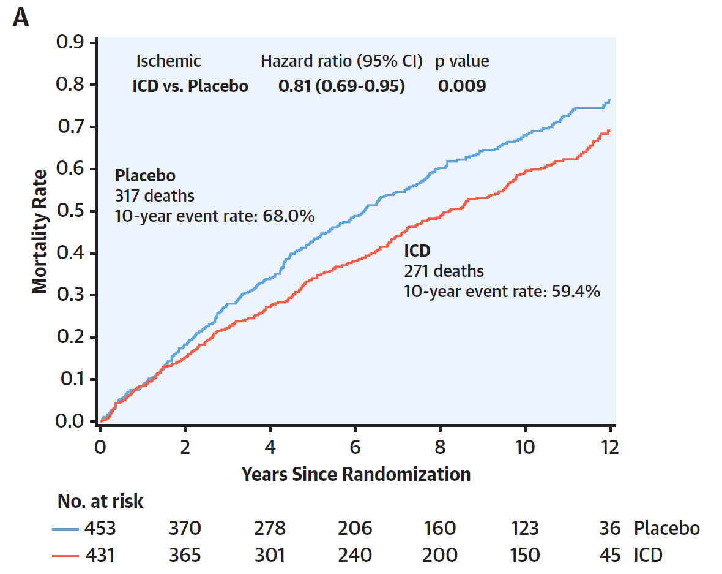
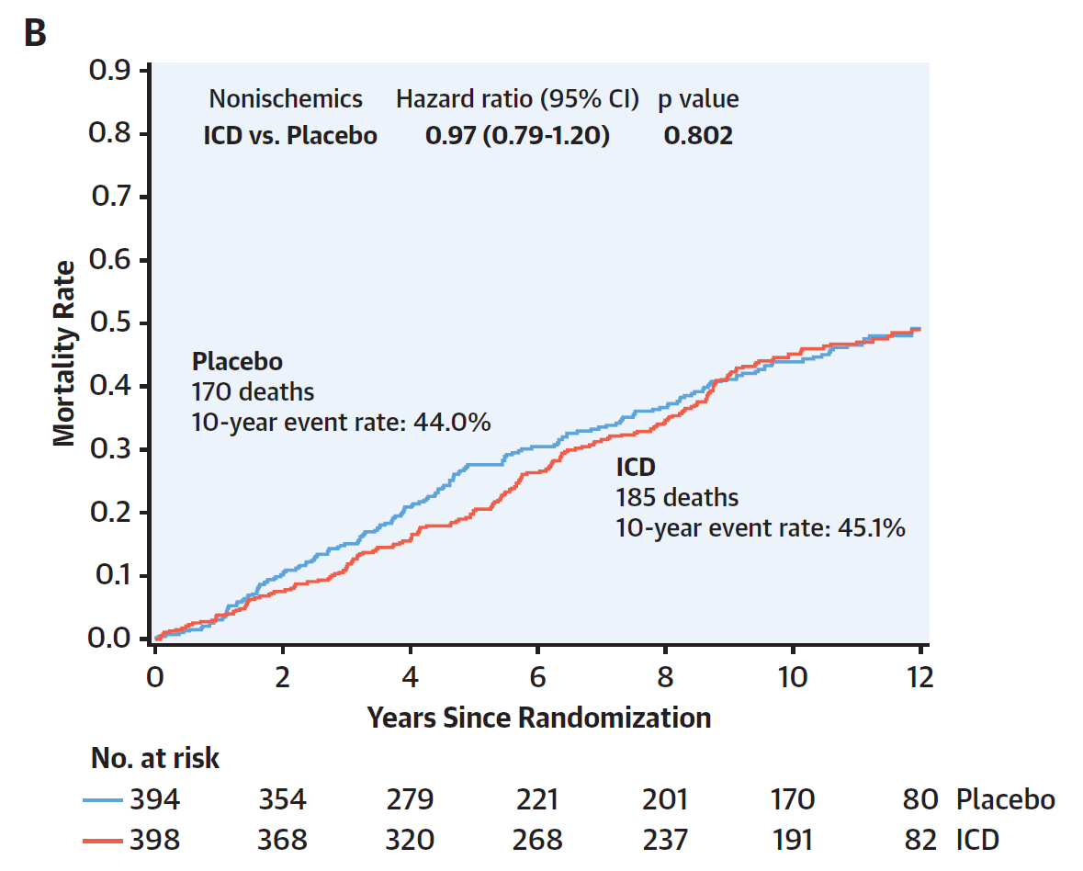
Long term follow-up of SCD-HeFT trial
Median follow-up was 11.0 years
This study is limited by incomplete mortality data in 9% of the original population. We had limited data regarding late crossovers to ICD or CRT-D, medication use, reasons for continued amiodarone use, ejection fraction, and other key clinical parameters. Potential bias could be introduced in these comparisons due to placebo and amiodarone
patients crossing over and receiving an ICD or CRT-D during extended follow-up.
The magnitude of long-term benefit from the ICD is heterogenous and depends upon the etiology and severity of HF.

Slide 10
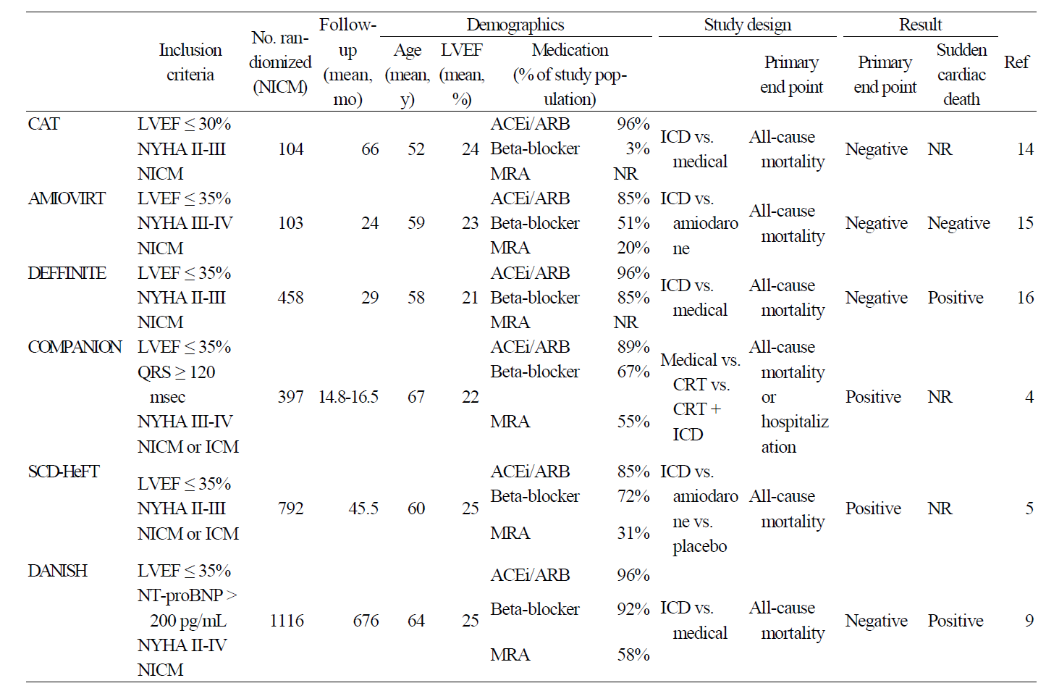
The summary of randomized controlled trials (for the primary prevention)
Korean J Med 2017;92:17-23

Slide 11
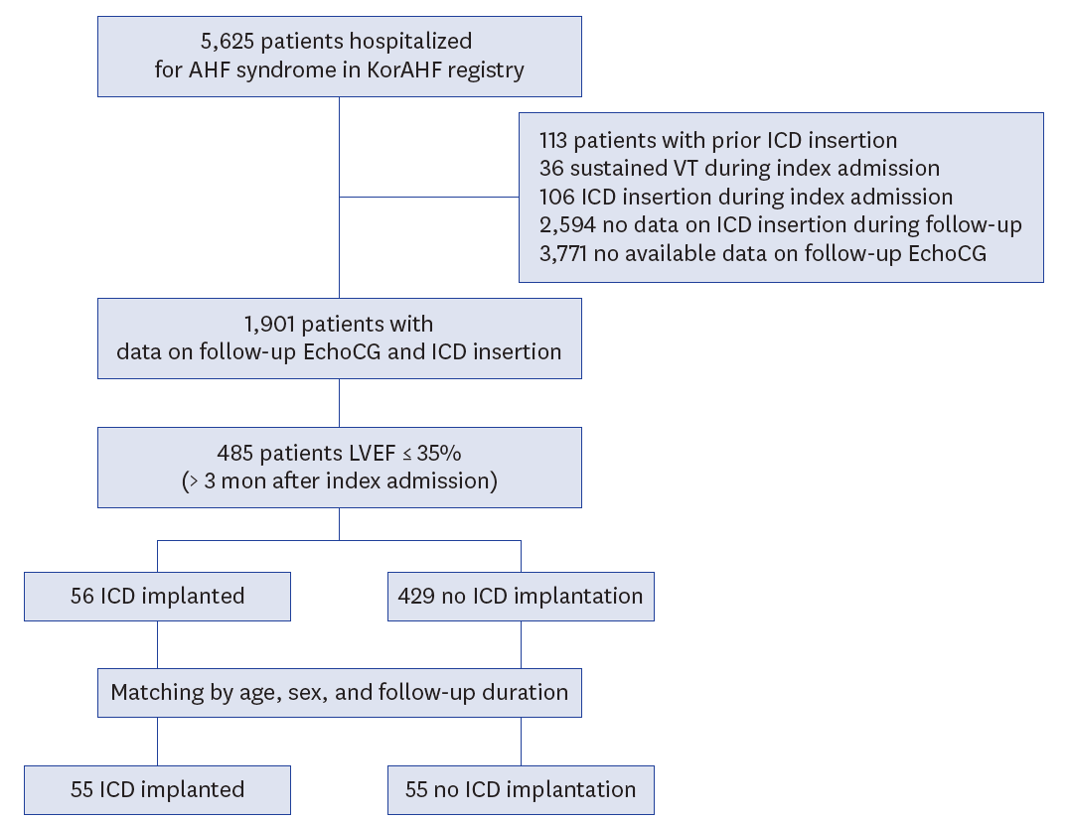
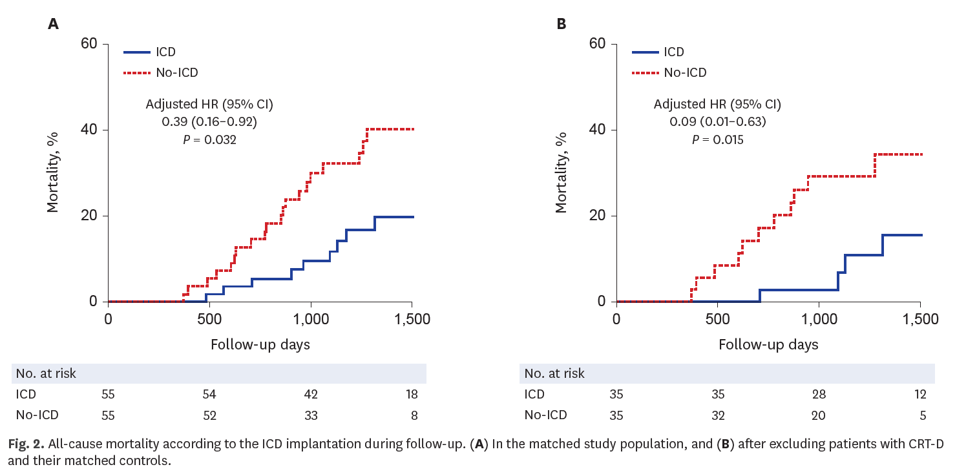
ICD Utilization and Its Outcomes in Korea
Among 485 patients potentially indicated for an ICD for primary prevention, only 56 patients (11.5%) underwent ICD implantation during the follow-up. In conclusion, follow-up data of this large multicenter KorAHF registry suggests a significant under-utilization of ICD in Korean heart failure patients with reduced LVEF. Survival analysis implies that benefits of ICD proven in clinical trials from western countries could be extrapolated to Korean patients.
J Korean Med Sci. 2020 Nov 30;35(46):e397

Slide 12
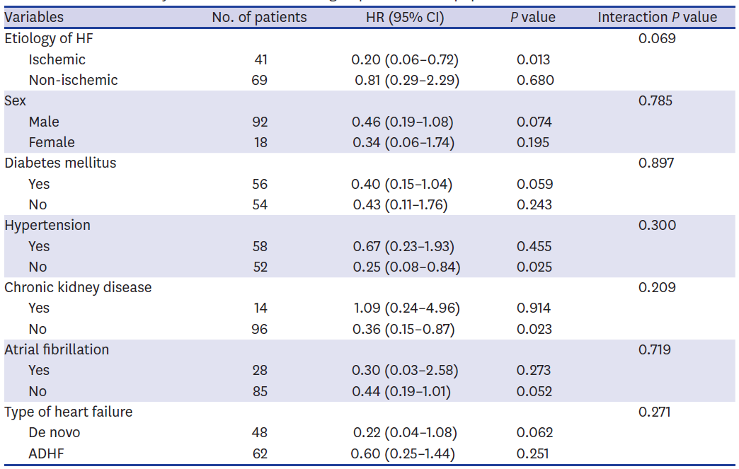
ICD Utilization and Its Outcomes in Korea
J Korean Med Sci. 2020 Nov 30;35(46):e397

Slide 13
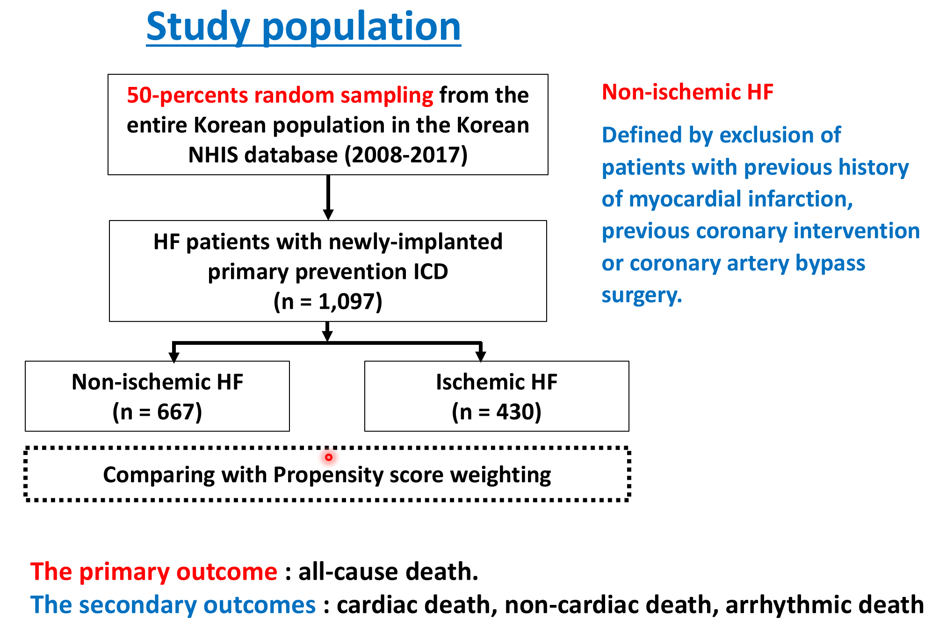
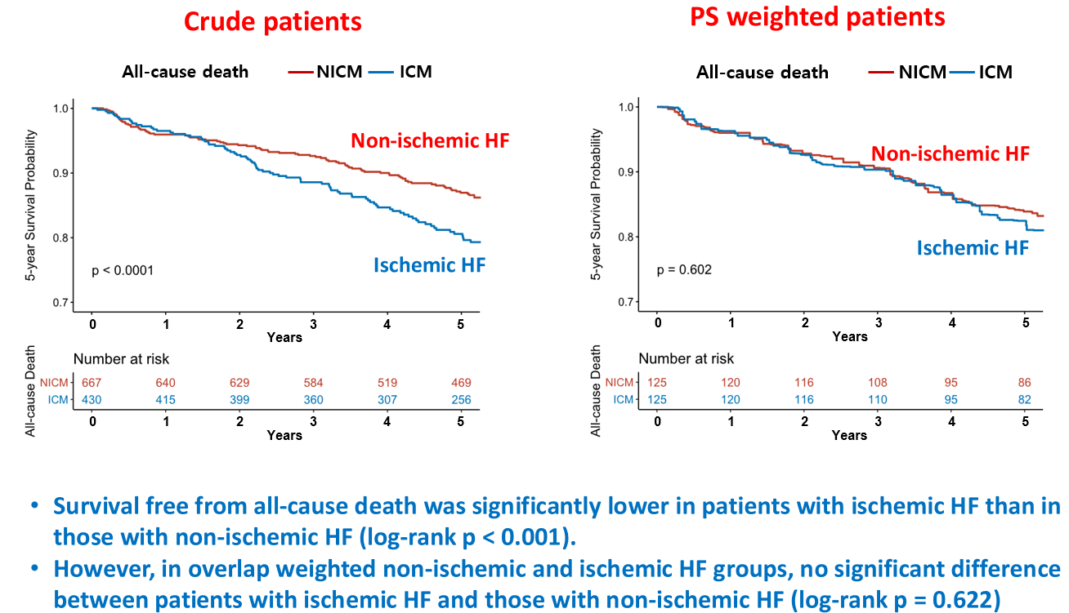
Real world data in Korea
In contemporary HF patients undergoing prophylactic ICD implantation in Korea, all-cause, cardiac, and non-cardiac mortality rates were similar between patients with non-ischemic and ischemic HF when weighting is performed to account for differences in patient characteristics. So, the benefit of prophylactic ICD therapy in HF patients should not be restricted to ischemic patients.
We identified a higher overall mortality in HF patients who underwent ICD implantation in Korea compared to that in recently published DANISH trial, with a lower usage of HF medications (beta-blockers, ACEI/ARBs, etc.).
Yang PS, 2021 KHRS oral presentation

Slide 14
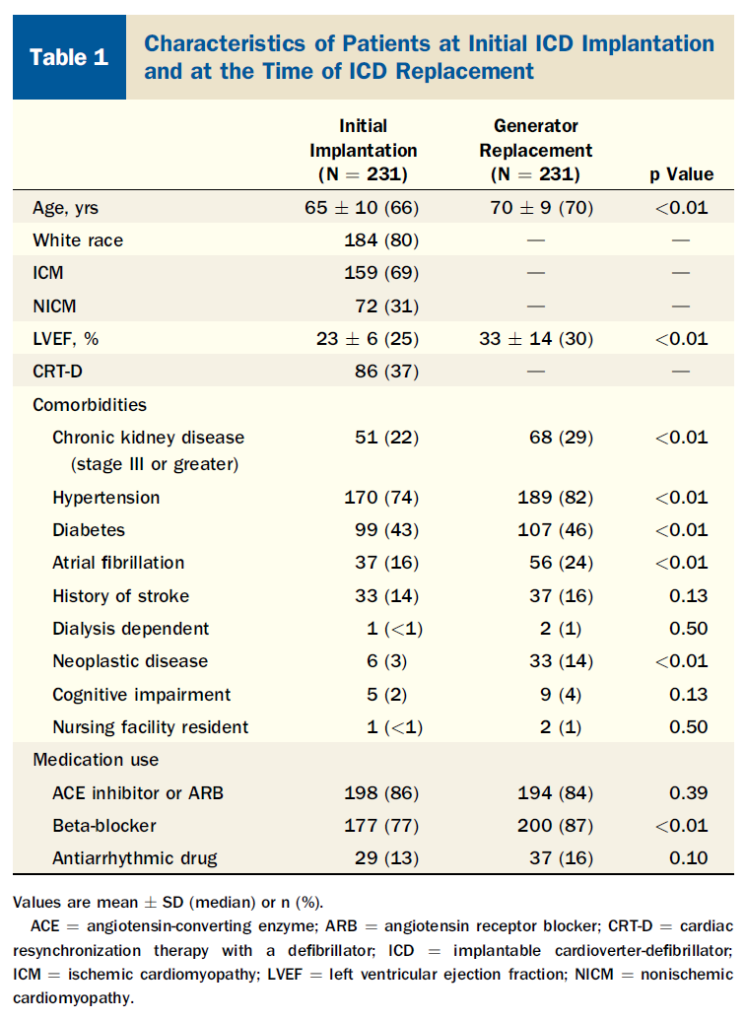
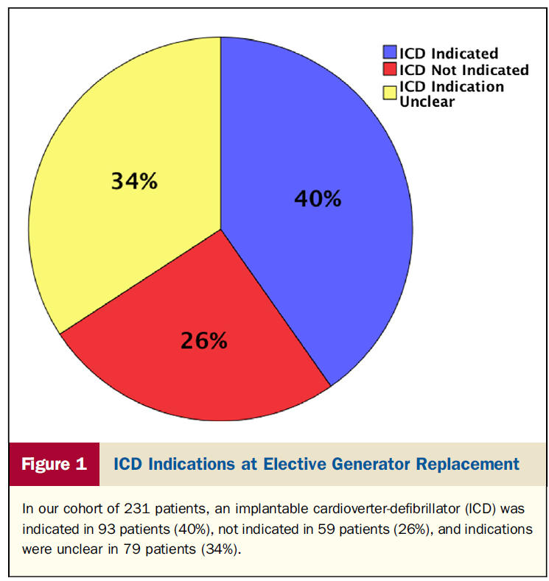
Appropriateness of Primary Prevention ICDs
at the Time of Generator Replacement
J Am Coll Cardiol 2014;63:2388–94

Slide 15
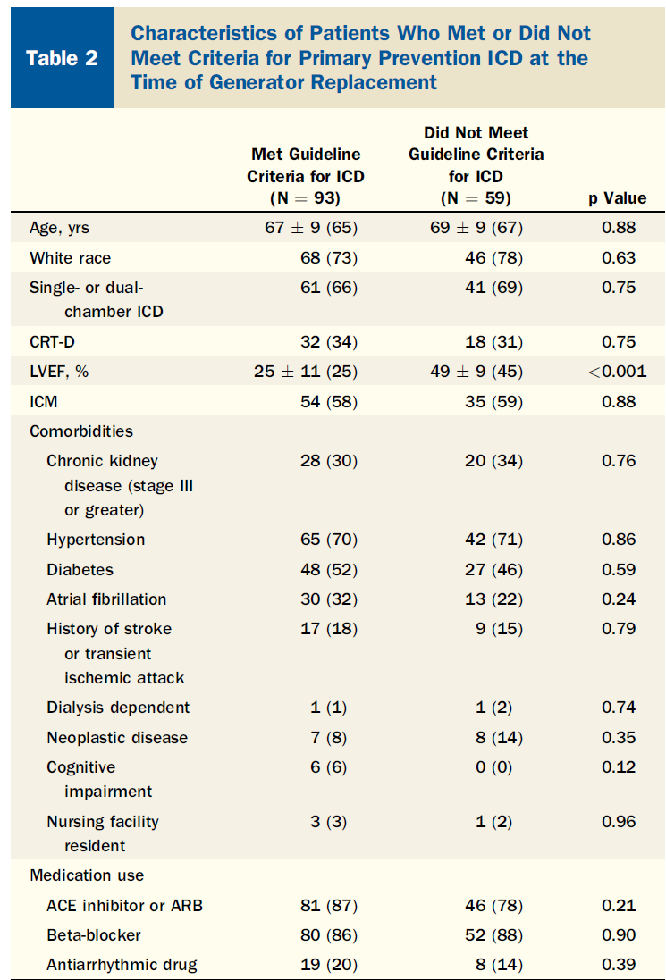
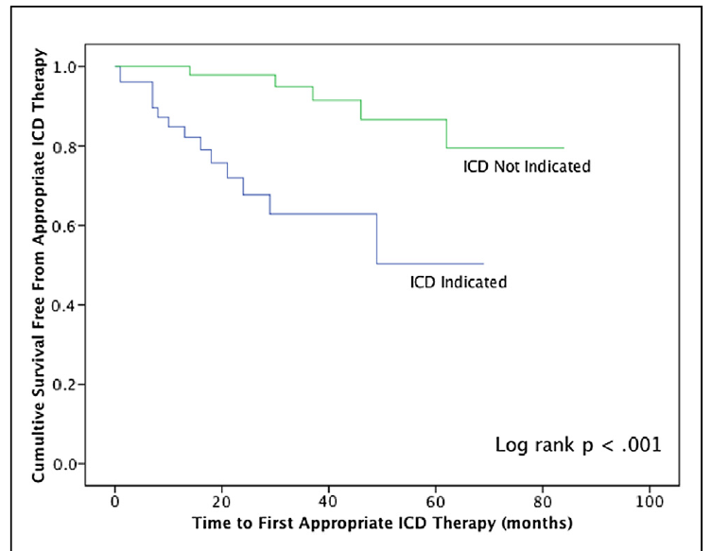
Comparison of patients who did and did not meet primary prevention criteria at generator change
Occurrence of appropriate ICD therapies after generator replacement
Appropriate ICD therapy rate : 10.7% vs. 2.8%
Approximately 25% of patients who receive primary prevention ICDs may no longer meet guideline indications for ICD use at the time of generator replacement, and these patients receive subsequent ICD therapies at a significantly lower rate.
J Am Coll Cardiol 2014;63:2388–94

Slide 16
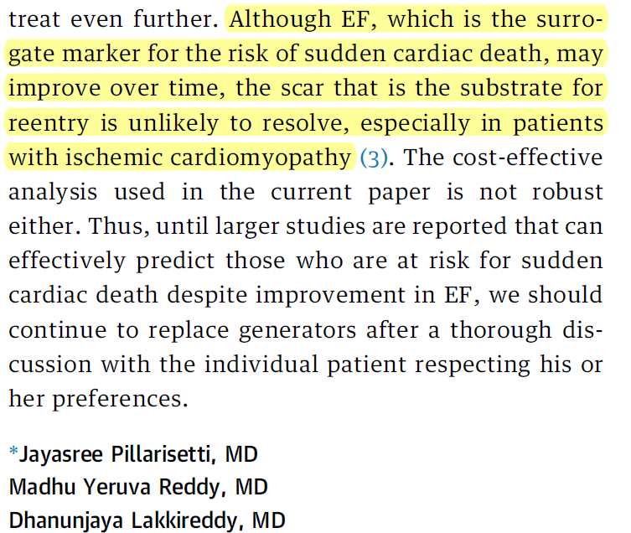
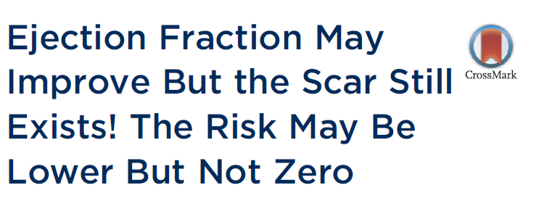

Slide 17
Heart Failure With Recovered
Left Ventricular Ejection Fraction (HFrecEF)
Working definition of HFrecEF
documentation of a decreased LVEF <40% at baseline;
≥10% absolute improvement in LVEF
a second measurement of LVEF >40%
J Am Coll Cardiol 2020;76:719–34

Slide 18
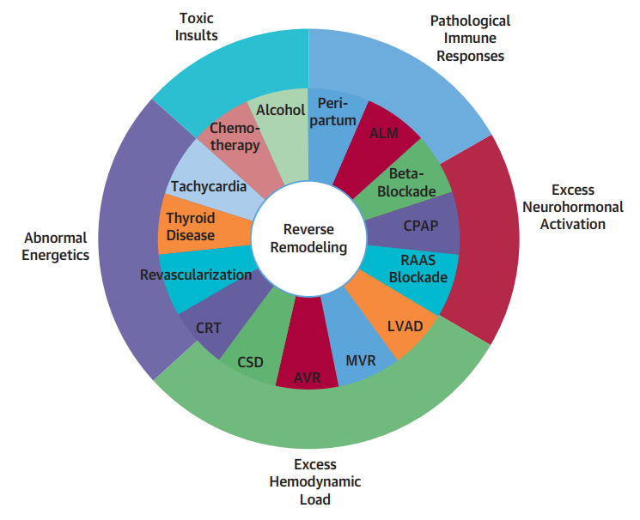
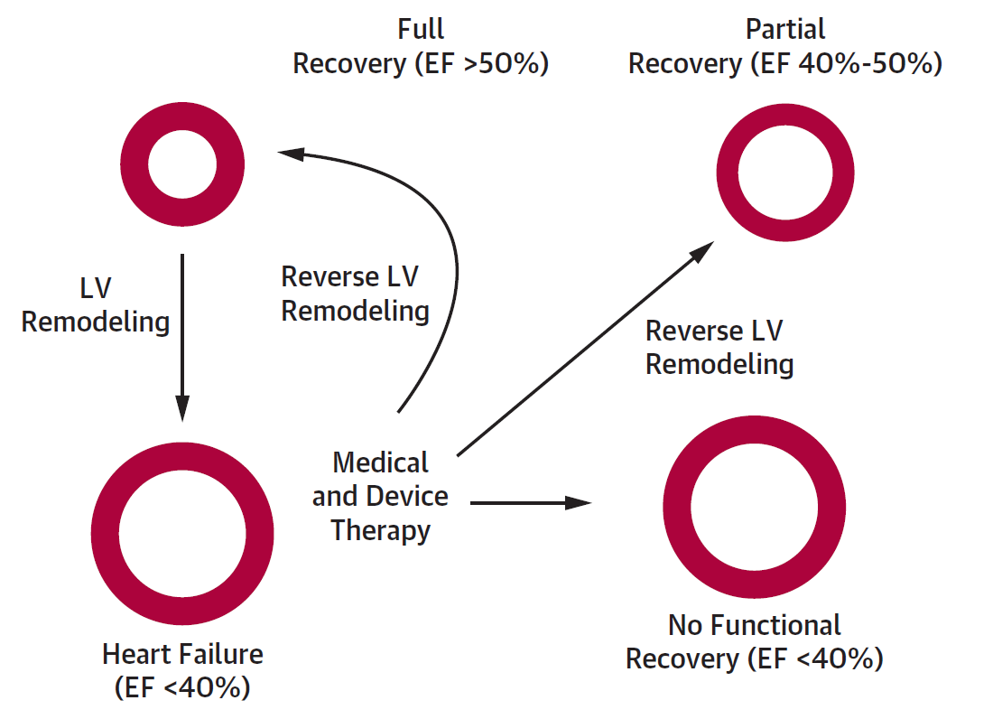
Changes in LVEF With GDMT in Patients With Heart Failure With a Reduced EF
& Recovery of LVEF in clinical setting
J Am Coll Cardiol 2020;76:719–34

Slide 19
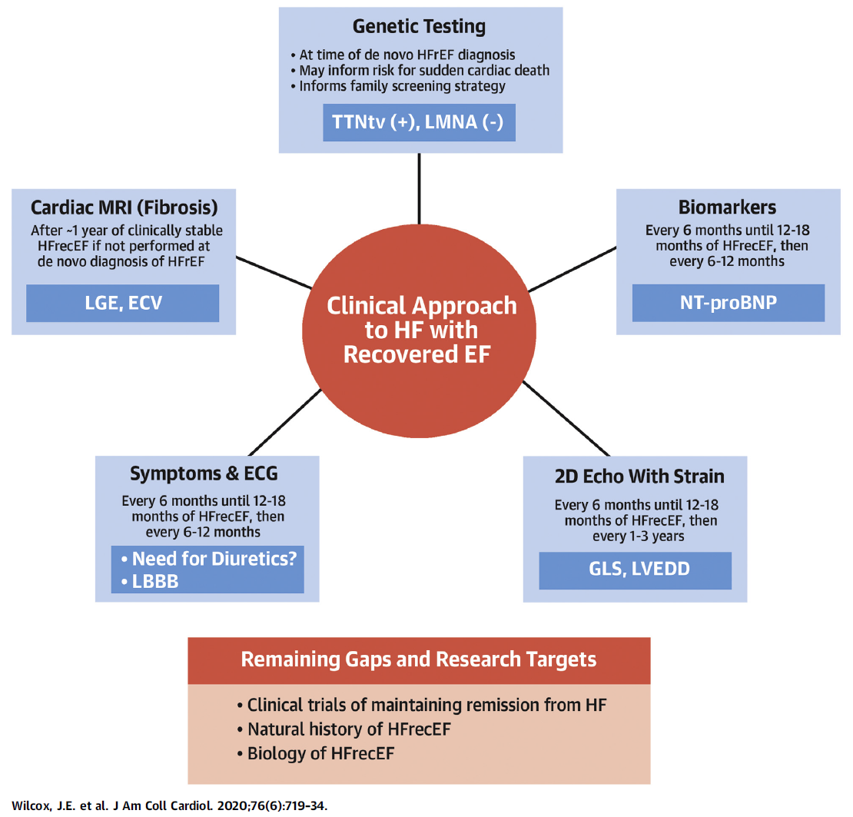
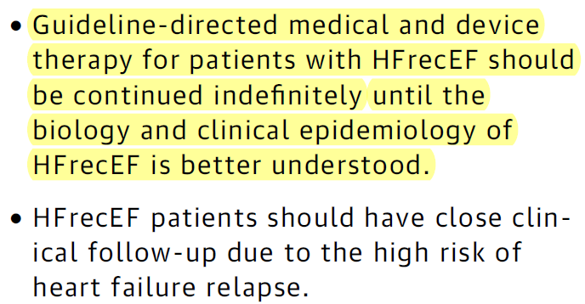

Slide 20
Natural history of HFrecEF
Cardiomyocyte dysfunction that result in HFrEF are partially modifiable, however, persistent abnormalities in myofibril mechanics and myocyte biology do not resolve fully.
Significant proportion will develop recurrent LV dysfunction accompanied by recurrent HF events.
Myocardial “remission” rather than a true cure of HF.
J Am Coll Cardiol 2020;76:719–34

Slide 21
Is implantable-cardioverter defibrillator generator
change indicated in HFrecEF patients?
Guidelines do mention that ICD therapy may be appropriate for patients who carry certain pathogenic genetic mutations associated with high arrhythmia risk regardless of LVEF if clinical HF is present.
Because fatal arrhythmias may occur despite normalization of LVEF, considerations for prophylactic placement of an ICD have been recommended independent of EF.
There are no prospective trials of ICD therapy among HFrecEF populations.
The best evidence to date, the data would support ICD generator change for most patients with HFrecEF, especially if a deleterious genetic mutation associated with high arrhythmia risk is present, history of appropriate shocks is documented, or the ECG remains abnormal.
J Am Coll Cardiol 2020;76:719–34

Slide 22
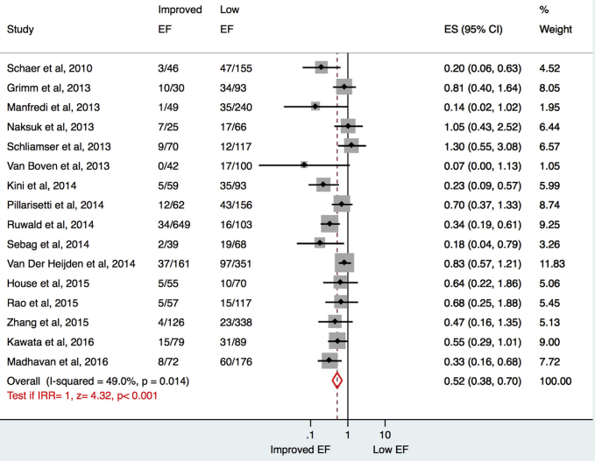
A Meta-Analysis
16 studies including MADIT-CRT, DEFINITE, 3959 pts
improvement in LVEF to >35% “improved LVEF group”
Appropriate ICD therapy rates were significantly lower in the improved LVEF group compared with the low LVEF group
In the meta-analysis, improved LVEF group had significantly lower (3.3% vs 7.2% per year IRR 0.52; CI 0.38 to 0.70; p <0.001) appropriate ICD therapies which was uniformly seen across all subgroups (ICD-only studies: IRR 0.59; p [ 0.004)
A Smer et al. Am J Cardiol 2017;120:279-86

Slide 23
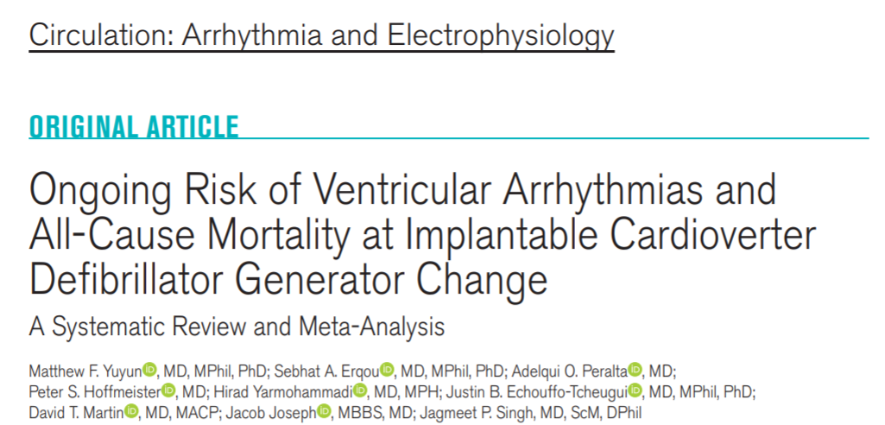
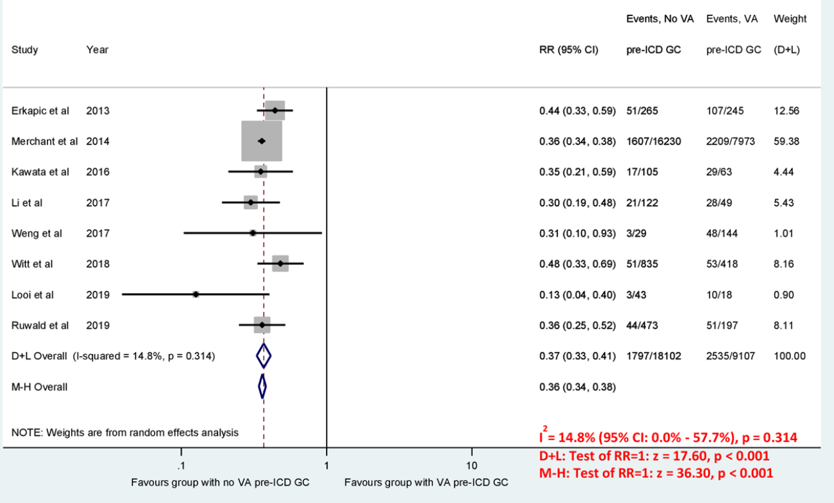
A Systematic Review and Meta-Analysis
In 15 studies that included 29 730 patients, 25.3% had LVEF improvement >35% at time of generator change
Appropriate ICD therapies; 4.6% vs 10.7%, RR; 0.50 (0.36–0.68), p<0.0001
All-cause mortality; 6.6% vs 10.9% per yr, RR; 0.65 (0.62–0.69), p<0.0001.
Ventricular arrhythmia was significantly lower in patients without prior ICD therapies (3.9% per annum), compared with those with prior ICD therapies (12.5 % per annum), RR 0.37 (0.33–0.41), p<0.001.
Circ Arrhythm Electrophysiol. 2021;14:e009139

Slide 24
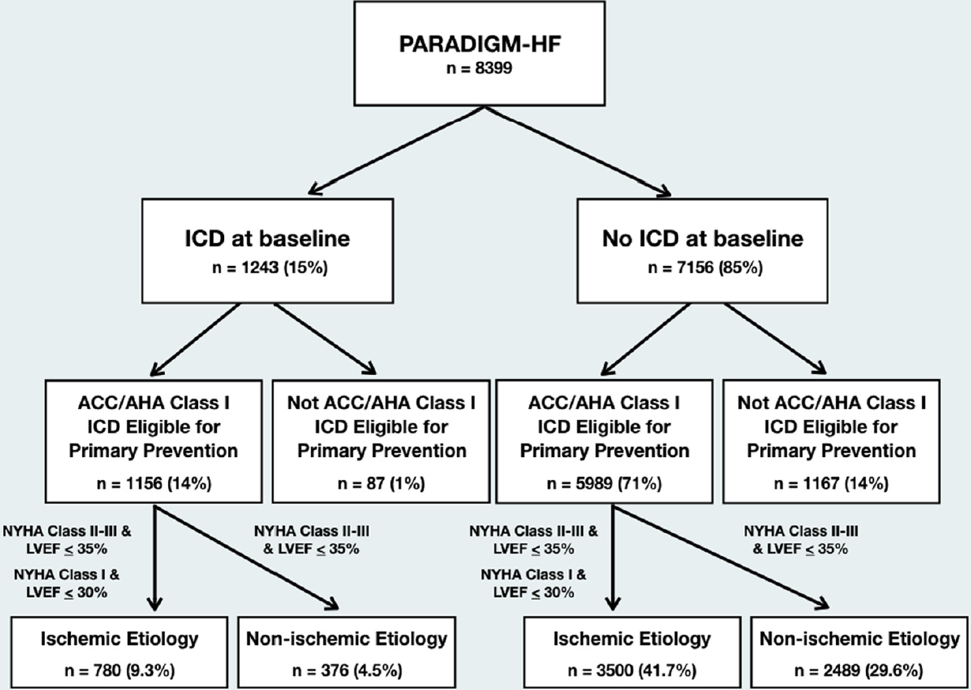
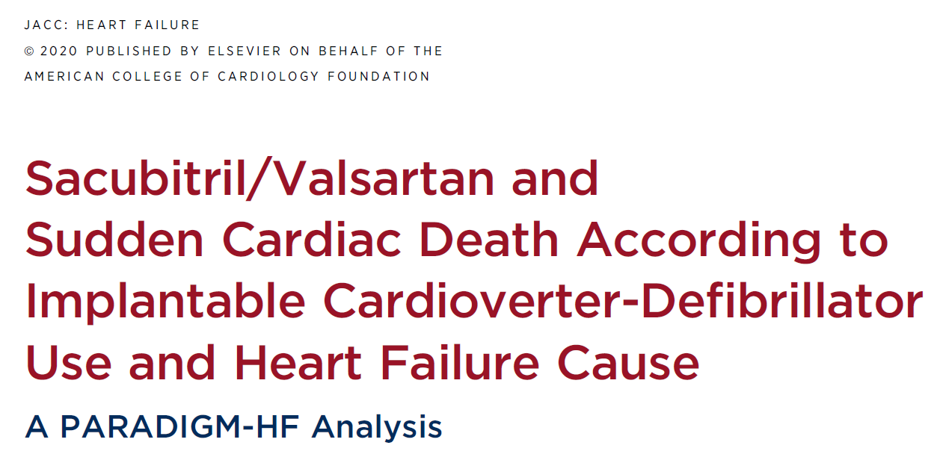
Sacubitril/Valsartan and SCD according to ICD
J Am Coll Cardiol HF 2020;8:844–55

Slide 25
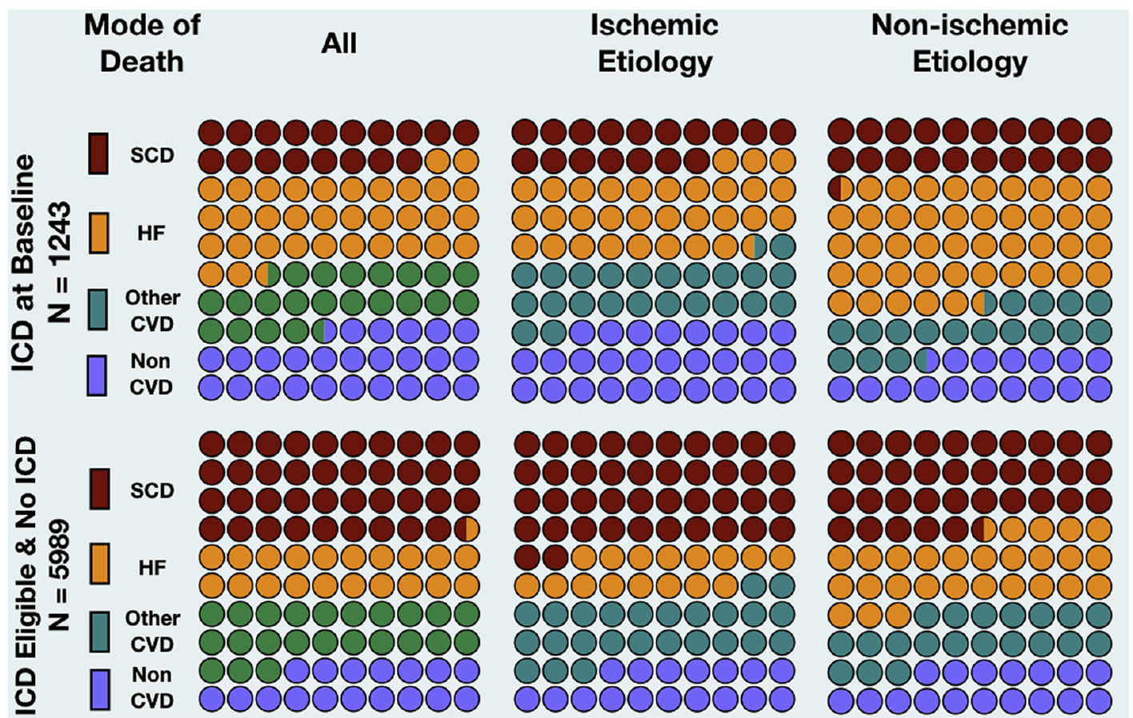
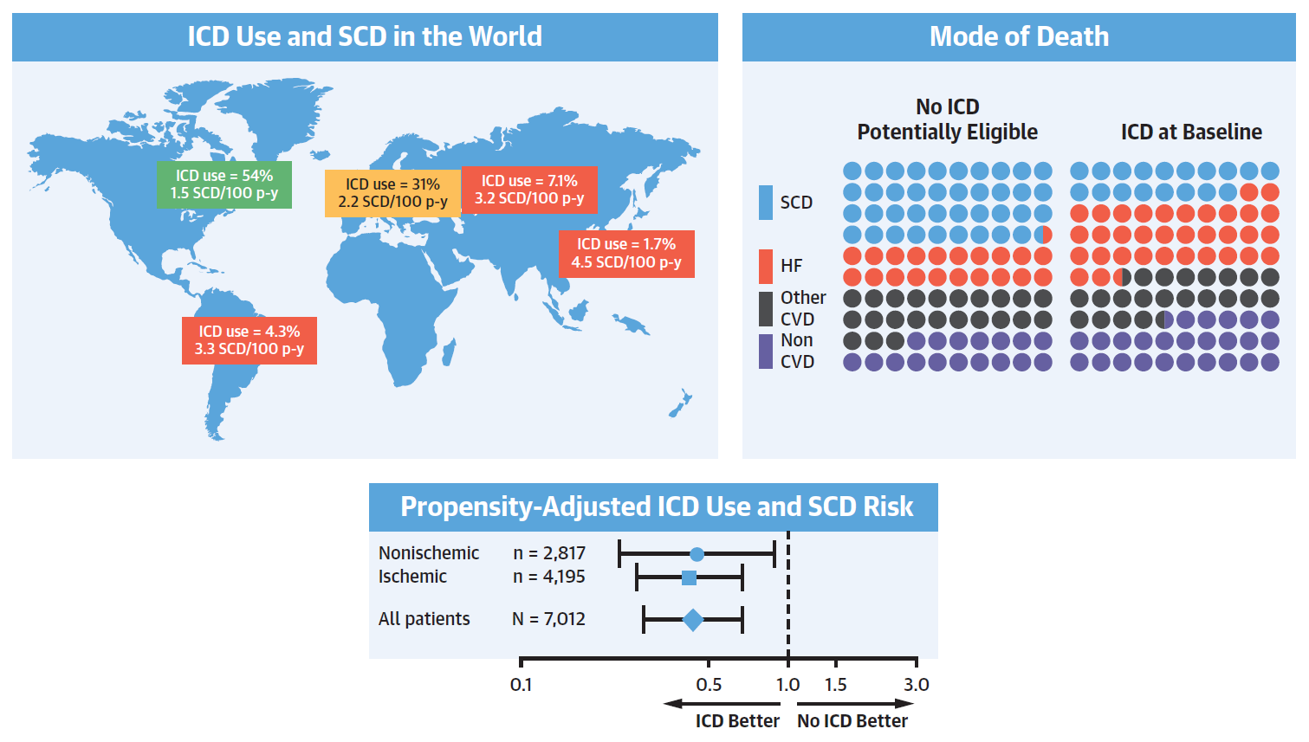
Sacubitril/Valsartan and SCD according to ICD
J Am Coll Cardiol HF 2020;8:844–55

Slide 26
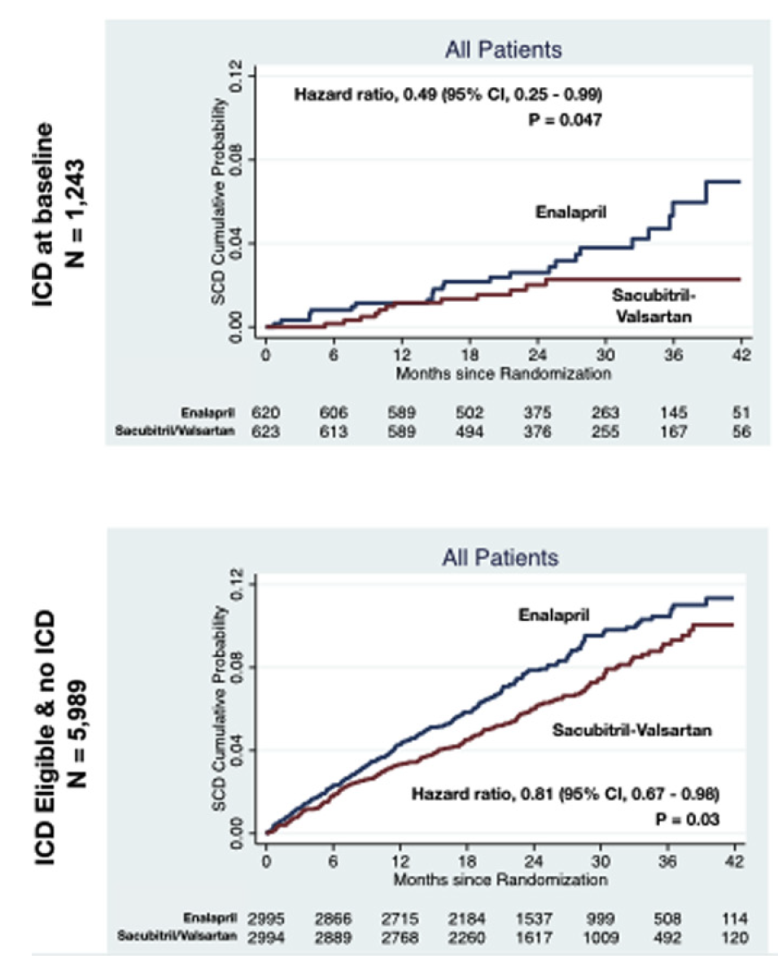
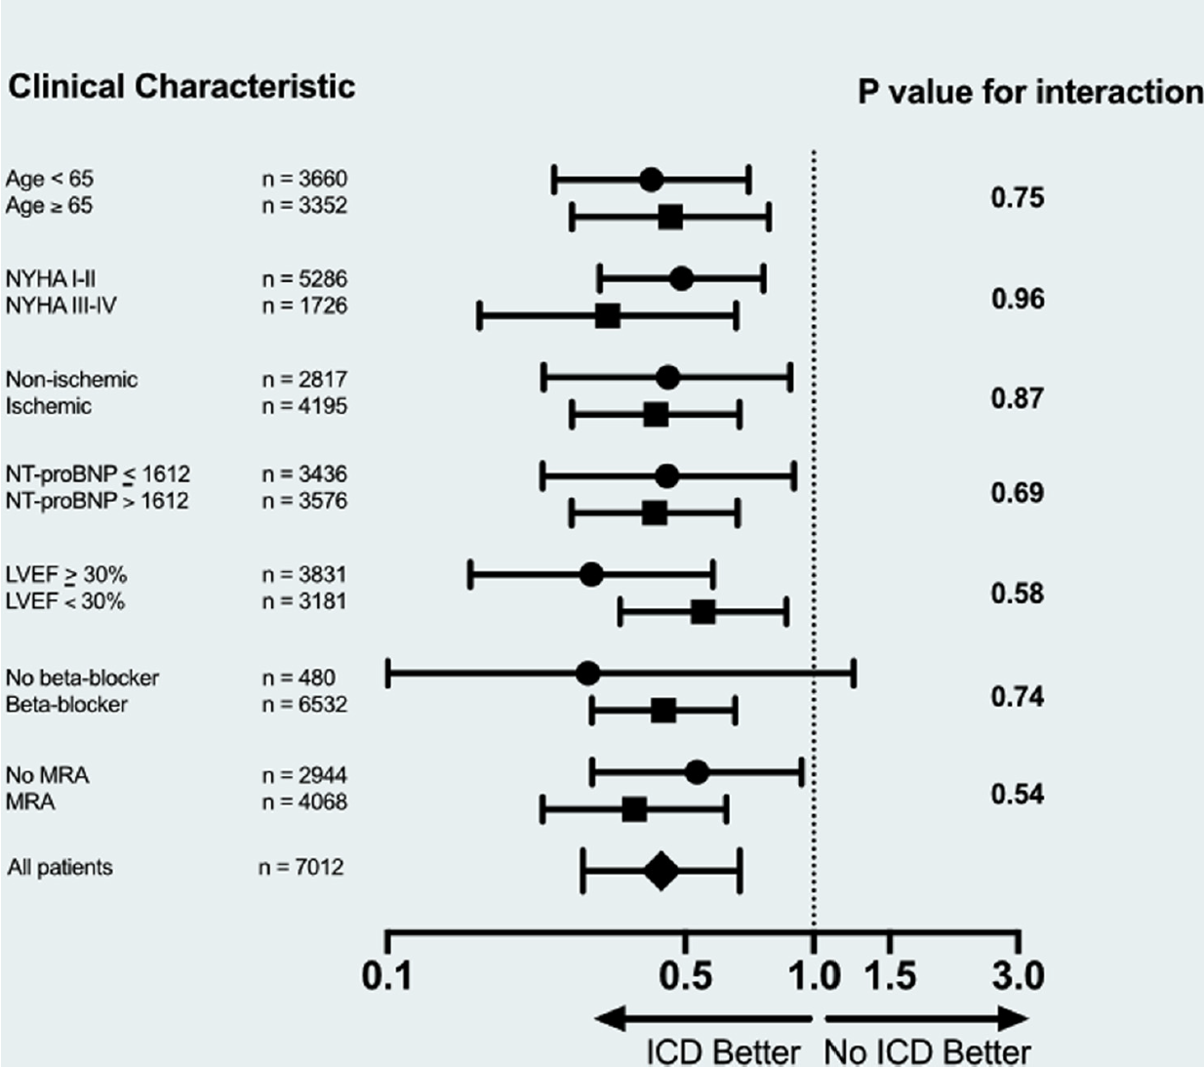
Sacubitril/Valsartan and SCD according to ICD
Use of ICD was associated with a 56% lower risk of SCD in patients meeting ACC/AHA eligibility for a primary prevention (HR: 0.44; 95% CI: 0.30 to 0.64 p < 0.001).
Sacubitril/valsartan significantly reduced SCD in both ICD and no ICD with eligible patients.
J Am Coll Cardiol 2020;76:719–34

Slide 27
In summary
Until now, there are no prospective trials of ICD therapy among these patients. However, based on the best evidence to date,
Should we change ICD generator in patients who have not experienced prior aborted cardiac arrest or syncope? Yes
Is ICD generator change indicated in HFrecEF patients? Yes
In particular, the role of ICD in NICM should be limited to preventing SCD, and more prospective studies are needed for the role of new HF medications (Sac/val (ARNI), SGLT2-i..) as alternative to ICD (Factors associated with high arrhythmia risk regardless of LVEF).

Slide 28
감사합니다

